Slide 1
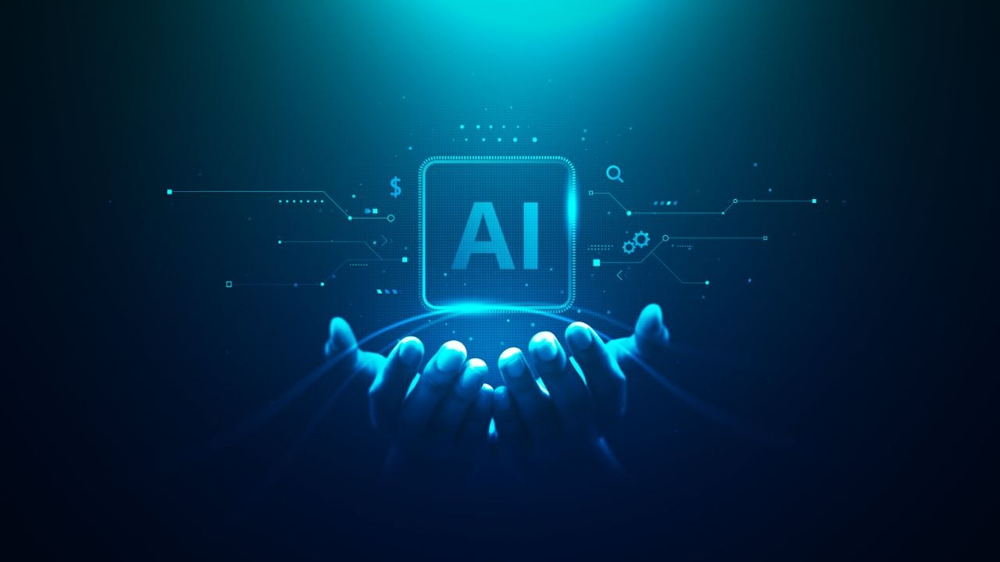
Artificial Intelligence — Technology of the Future
Prepared by Polina Kyrpychenko
Student of Group П-31

Slide 2
Contents
1. What is Artificial Intelligence?
2. Where is AI used?
3. AI in Medicine
4. Advantages of AI
5. Risks of AI
6. AI in the Future
7. References

Slide 3
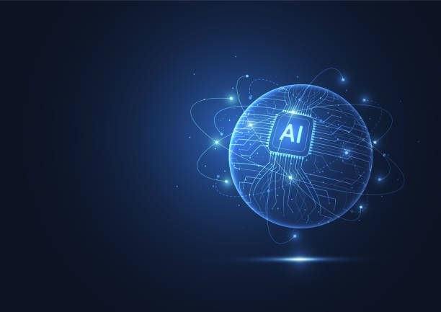
Why I chose this topic
I chose this topic because artificial intelligence is becoming an important part of modern life.
AI is used in smartphones, medicine, education, and transport.
I think this technology will greatly influence our future.

Slide 4
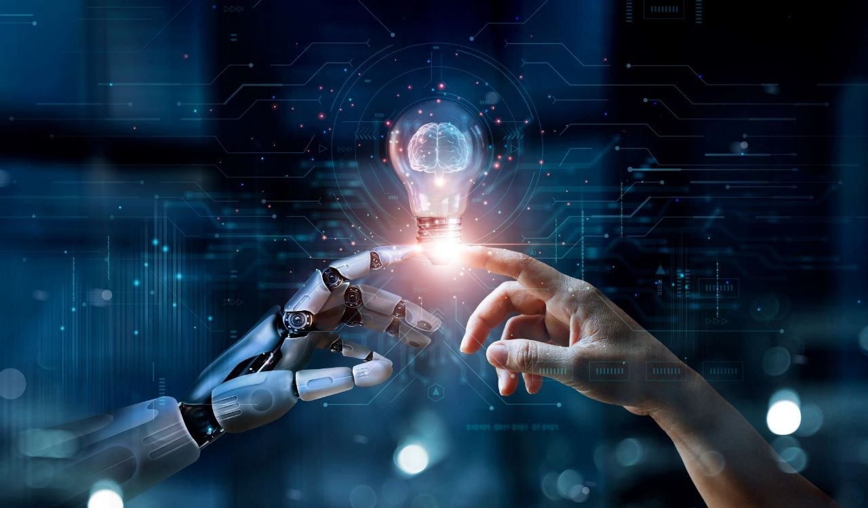
What is Artificial Intelligence?
Artificial Intelligence (AI) is a technology that allows computers to think, learn, and make decisions.
AI can:
-analyze information;
-recognize speech and images;
-solve problems;
-help people in everyday life.

Slide 5
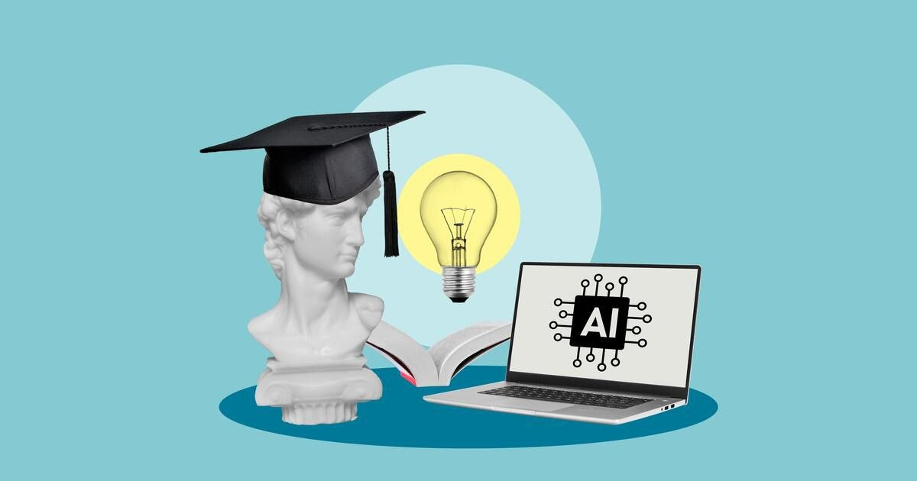
Where is AI used?
AI is used in many areas:
-smartphones and voice assistants;
-online applications;
-transport;
-education;
-social networks.

Slide 6
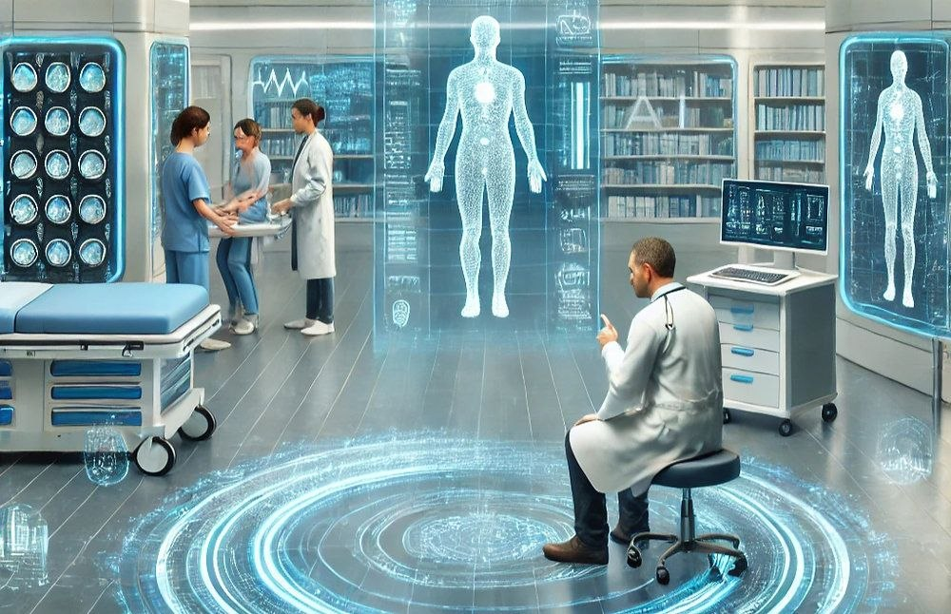
AI in Medicine
Artificial intelligence helps doctors:
find diseases faster;
analyze medical images;
create new medicines;
improve medical treatment.

Slide 7
Advantages of AI
Advantages:
-saves time;
-works quickly;
-helps people;
-improves technology;
-automates difficult tasks.

Slide 8
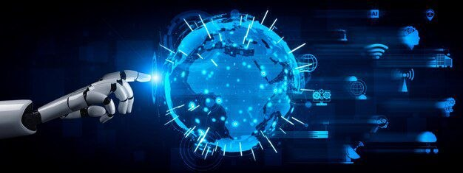
Risks and Future of AI
Risks:
cybercrime;
dependence on technology;
loss of some jobs.
Future:
smart robots;
autonomous transport;
more advanced technologies.

Slide 9
References
1. Books about Artificial Intelligence
2. Internet articles about modern technologies
3. Educational websites about AI and robotics
4. Technology news websites

Slide 10
